Slide 1
Full Stack Web Development
Full Stack Web Development / Course Intro

Slide 2
About The Instructor
Brad Traversy
12+ years as a web developer
4+ years creating and teaching courses
Specialize in JavaScript technologies and PHP server-side development
Dozens of courses at Eduonix.com

Slide 3
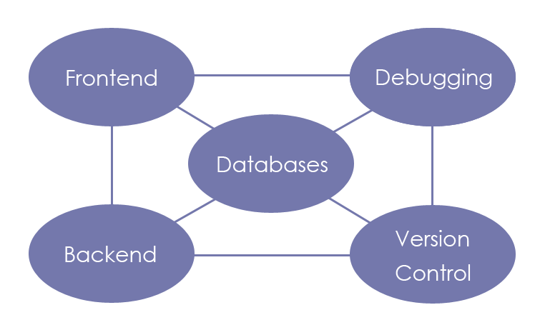
Course Description
This course includes over 20 different technologies within 5 categories. There are 40+ projects, mini-projects and code samples. By the end of this course you should consider yourself a Full Stack Developer
5 Areas – Frontend, Backend, Databases,
Essential Technologies, Debugging & Tools
Each area has 4 – 6 sections
Each section has 4 – 12 Lectures
Each Lecture has 1 – 6 videos with source code

Slide 4
Frontend Technologies
HTML – All the basics: tags, attributes, lists, forms, etc
HTML5 – Video/audio, Canvas, Web Storage, Geolocation
CSS3 – Positioning, gradients, transitions, pseudo classes
Twitter Bootstrap – Navbar, jumbotron, alerts, grids
JavaScript – Arrays, objects, form validation, ajax
jQuery – Selectors, DOM manipulation, events, image slider

Slide 5
Backend Technologies
Node.js – NPM, Express, template engines, authentication
Meteor.js – Templates, collections, subscriptions
Angular – Components, routing, observables, events
PHP – OOP, MySQL, superglobals, sessions
Ruby On Rails – Controllers, models, views, routing

Slide 6
Databases
MySQL – Tables, queries, joining, PHP integration
PostgreSQL – psql client, PGAdmin4, PHP Integration
MongoDB – Collections, queries, documents, Mongoose
CouchDB – Fauxton, design docs, views, replication

Slide 7
Other Essential Technologies
Memcached – Telnet commands, libmemcached-tools
Redis – Caching, data persistence, data types
Markdown – Headings, lists, text formatting
Sass – Variables, mixins, extending, partials

Slide 8
Version Control & Debug
GIT – Version control, repositories, Github
Grunt – Tasks, concatenation, watch mode
Gulp – Minify code, webserver, JSHint
Chrome Developer Tools – Debugging, console, inspection
PHP Debugging & Errors – Error types, debug functions, config

Slide 9
Project Examples
Simple HTML Template
Bootstrap Theme
jQuery Slider
Ajax Github Profile Finder
PHP Job Board
CSS3 Dropdown menu
Ruby On Rails Blog
PHP / PostgreSQL Blog
RESTful JSON API
CD Collection Database
HTML5 Audio Player
Angular 2 Website
PHP Bookmarker
Sass Template
Node.js/Redis Todo List
Page Cache w/Memcached
Node.js / Passport Authentication System
PHP MySQL Messaging App
HTML5 Note App Using LocalStorage

Slide 10


